Slide 1
The number system
Number system and Binary numbers

Slide 2
What is the number system?
The number system is a writing system for expressing numbers.
It is composed of a collection of symbols used to represent small numbers, together with a system of rules for representing larger numbers.

Slide 3
Example of a 32-bit instruction
LDR <Rd>, [<Rn>, #<immed_5> * 4]
cond code
op code
32 bit ARM LDR
reserved

Slide 4
Example of a 32-bit instruction

Slide 5
The unary number system
What is the first numeral system we learn ?
What is the most natural numeral system?
1 | 2 | 3 | 4
The unary number system uses one symbol.
This is the simplest way of counting

Slide 6
The Roman number system
Numbers in the Roman system are represented by combinations of letters from the Latin alphabet.
Roman numerals used today, have seven symbols, each with a fixed integer value:
Symbol | I | V | X | L | C | D | M
Value | 1 | 5 | 10 | 50 | 100 | 500 | 1,000

Slide 7
The base of a number system
A radix, or base, is the number of unique digits, including zero, used to represent numbers in a positional numeral system.
image credit: http://theplctutor.com/decimal.html

Slide 8
The base of a number system
Generalized form of positional systems in Base B:
Commonly used numeral systems include:
Binary (Base 2): 0, 1
Octal (Base 8): 0, 1, 2, 3, 4, 5, 6, 7
Decimal (Base 10): 0, 1, 2, 3, 4, 5, 6, 7, 8, 9
Hexadecimal (Base 16): 0, 1, 2, 3, 4, 5, 6, 7, 8, 9, A, B, C, D, E, F

Slide 9
The base of a number system
Consider a number N with n+1 digits:
N = d_{n} d_{n-1} d_{n-2} ... d₀
N_{B} = d_{n} × B^{n} + d_{n-1} × B^{n-1} + d_{n-2} × B^{n-2} + ... + d₁ × B¹ + d₀ × B⁰
most significant digit
least significant digit

Slide 10
The Egyptian number system
The Egyptians had a base-10 system of hieroglyphs for numerals.
They separate symbols for one unit, one ten, one hundred, one thousand, one ten thousand, one hundred thousand, and one million.

Slide 11
The Egyptian number system
e.g. The number 276 in hieroglyphs, requires fifteen symbols:

Slide 12
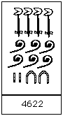
The Egyptian number system
e.g. The number 4622 in hieroglyphs, requires these symbols:

Slide 13
Decimal to binary conversion
Conversion of a number from decimal to binary:
To convert a decimal number to binary:
First, subtract the largest possible power of two
Keep subtracting the next largest possible power of 2 from the remainder, marking 1s in each column where this is possible and 0s where it is not.

Slide 14
Decimal to binary conversion
Converting the decimal (base 10) number 86 to binary (base 2)
64 is the largest power of 2 that goes into 86. The result is:
86 - 64 is 22. 32 is larger than 22, so a 0 is placed in the bit for the value 32. 16 is less than 22, so a 1 is placed in the bit for the value 16.
22 - 16 is 6. 8 is larger than 6.
The bits 4+2 equal 6 so each of those bits become 1
This 86 in decimal is 1010110 in binary. 86₁₀ = 1010110₂
1 | ? | ? | ? | ? | ? | ?
64 | 32 | 16 | 8 | 4 | 2 | 1
1 | 0 | 1 | ? | ? | ? | ?
64 | 32 | 16 | 8 | 4 | 2 | 1
1 | 0 | 1 | 0 | 1 | 1 | 0
64 | 32 | 16 | 8 | 4 | 2 | 1

Slide 15
Binary to decimal conversion
Conversion of a number from binary to decimal:
N₂ =
The value of N₂ in the Decimal Base N₁₀ is:
N₁₀ = 1 × 2⁹ + 0 × 2⁸ + 0 × 2⁷ + 0 × 2⁶ + 0 × 2⁵ +1 × 2⁴ +1 × 2³ +
0 × 2²+ 0 × 2¹ +1 × 2⁰
= 537
1 | 0 | 0 | 0 | 0 | 1 | 1 | 0 | 0 | 1
9 | 8 | 7 | 6 | 5 | 4 | 3 | 2 | 1 | 0

Slide 16
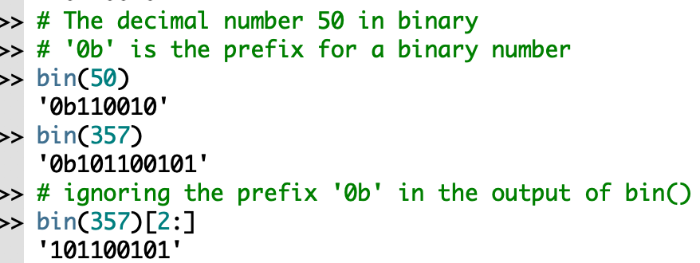
Binary conversion: bin()
The bin() function converts an integer to a binary string.
input: the integer to convert to binary
output: a binary string
If the input is not an integer, bin()raises a TypeError exception.

Slide 17
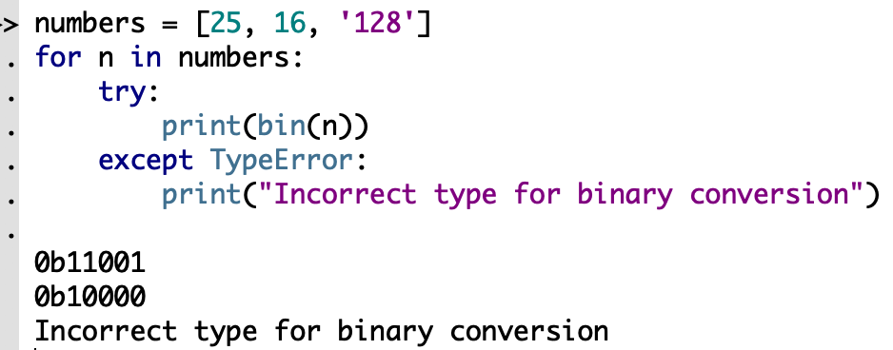
Binary conversion: bin()
The bin() function converts an integer to a binary string.
input: the integer to convert to binary
output: a binary string
If the input is not an integer, bin()raises a TypeError exception.

Slide 18
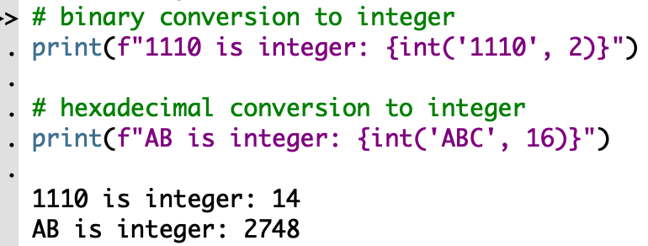
Decimal conversion: int()
The int() function converts any base k number to decimal.
The syntax of int() method is: int(x, base)
ABC is integer:
ABC

Slide 19
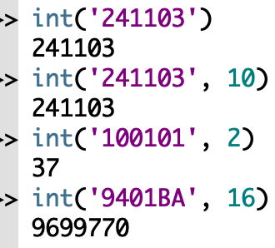
Decimal conversion: int()
The syntax of int() method is: int(x,base)
input x: number or string to convert
input base: base of the number in x
output: an integer

Slide 20
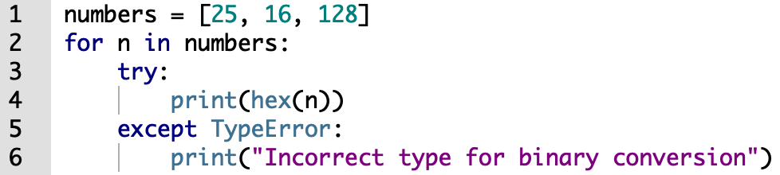
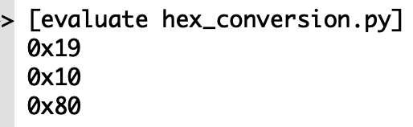
Number system: hexadecimal numbers
Conversion using Python functions.
The hex() function converts an integer to a hexadecimal number.

Slide 21
Number system: Binary addition
Rules for binary addition
0 + 0 = 0
0 + 1 = 1
1 + 0 = 1
1 + 1 = 10
for 1 + 1, we write down a zero in the right-most column and carry over a one to the next column.

Slide 22
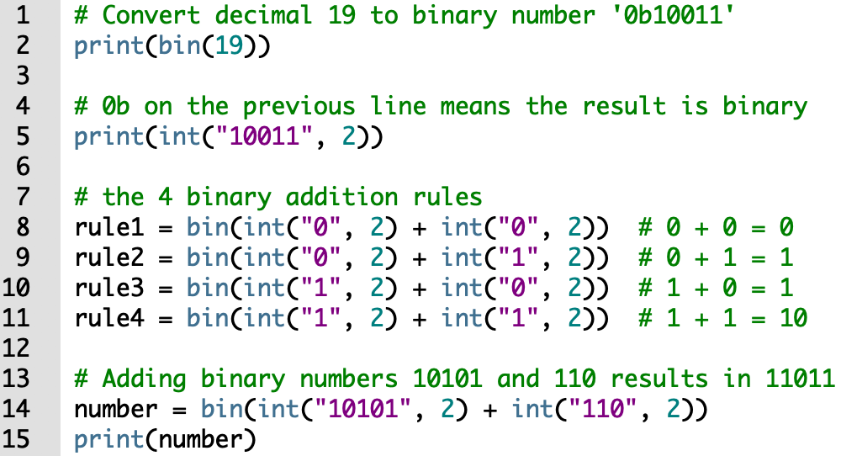
Number system: Binary addition

Slide 23
Number system: bitwise operators
Operator | Description
~ Binary NOT | Each bit of the output is 1 if the bit of x is 0, otherwise it is 0.
& Binary AND | Each bit of the output is 1 if the bit of x AND the bit of y is 1, otherwise it's 0.
| Binary OR | Each bit of the output is 0 if the bit of x AND the bit of y is 0, otherwise it’s 1.
^ Binary XOR | Each bit of the output is 1 if the bit of x is the one complement of the bit of y, otherwise it's 0
<< Binary Left Shift | x << y returns x with the bits shifted to the left by y places. Performs a multiplication of x by 2^{y}.
>> Binary Right Shift | x >> y returns x with the bits shifted to the right by y places. Performs a floor division of x by 2^{y}.

Slide 24
Bitwise operator: NOT (~)
The NOT of a binary number is the value obtained by inverting all the bits in the binary number.
We flip 0 to 1
We flip 1 to 0
Truth table:

Slide 25
Bitwise operator: NOT (~)
How to read the NOT of a binary number?
In programming we read the NOT of a binary number in 2’s complement format.
2's complement is a method of representing signed integers on computers.
To get the 2's complement of a binary number:
Invert all the bits.
Add 1 to the inverted bits.

Slide 26
Two's Complement Arithmetic
So far, the numbers we have discussed have had no size restriction on them
However, since computer arithmetic is performed in registers, this will restrict the size of the numbers
On some machines, this is 8 bits, others 16 bits, and others it is 32 or even 64 bits
To keep it simple, we'll use 4 bits at first
©1999-2017 by Timothy J. McGuire, Ph.D.
26

Slide 27
The Fabulous Four-bit Machine (FFM)‏
The possible numbers it can hold are:
0000, 0001, 0010, 0011, 0100, 0101, 0110, 0111,
1000, 1001, 1010, 1011, 1100, 1101, 1110, 1111
In order to identify particular bits in a byte or word, we use the following terms:
lsb -- least significant bit -- rightmost bit position
always numbered as bit 0
msb -- most significant bit -- leftmost bit position
on FFM it is bit 3
©1999-2017 by Timothy J. McGuire, Ph.D.
27

Slide 28
Unsigned Integers
An unsigned integer is one which is never negative (addresses of memory locations, ASCII codes, counters, etc.)‏
On the FFM, then, we can represent numbers from 0 to 15 (0000 to 1111)‏
On the Intel 8086 the range of integers is 0 to 2¹⁶-1 (0 to 65535); on the 386 it is 0 to 2³²-1.
If the lsb is 0, the number is even; if it is 1, the number is odd
©1999-2017 by Timothy J. McGuire, Ph.D.
28

Slide 29
Signed Integers
How do we represent negative numbers?
We have three possible methods:
Sign and magnitude
One's complement
Two's complement
©1999-2017 by Timothy J. McGuire, Ph.D.
29

Slide 30
Sign and Magnitude
The msb of the number represents the sign of the number
0 means positive, 1 means negative
On FFM
0000 to 0111 represent 0 - 7
1001 to 1111 represent -1 to -7
1000 is not used ( negative 0)‏
Easy to understand, but doesn't work well in computer circuits (too many special cases)‏
©1999-2017 by Timothy J. McGuire, Ph.D.
30

Slide 31
One's Complement
The one's complement of an integer is obtained by complementing each bit
The one's complement of 5 (0b0101) is 0b1010 = -5
The one's complement of 0 (0b0000) is 0b1111 = -0 (here we go again)‏
- 5 + 5 = 0101 + 1010 = 1111 = -0
The negative 0 problem can be solved by using two's complement
©1999-2017 by Timothy J. McGuire, Ph.D.
31

Slide 32
Two's Complement
To get the two's complement of an integer, just add 1 to its one's complement
The two's complement of 5 (0101) is 1010+1 = 1011
When we add 5 and -5 we get
0101
1011
10000
Because the FFM can only hold 4 bits, the 1 carried out from the msb is lost and the 4-bit result is 0
©1999-2017 by Timothy J. McGuire, Ph.D.
32

Slide 33
Complementing the Complements
It should be obvious that taking the 1's complement of a number twice will give the original number ( -(-5) = 5)‏
If the 2's complement is to be useful, it must have the same property
5 = 0101, -5 = 1011, -(-5) = 0100+1 = 0101
©1999-2017 by Timothy J. McGuire, Ph.D.
33

Slide 34
Moving past 4 bits
Everything true of the FFM is still true for 8, 16, 32, or even 64 bit machines
Example: Show how the base-10 integer -97 would be represented in (a) 8 bits and (b) in 16 bits, expressing the answer in hex
(a)‏
97 = 6x16+1 = 0x61 = 0b0110 0001
-97 = 1001 1110 + 1 = 0b1001 1111b = 0x9F
(b)‏
97 = 0b0000 0000 0110 0001
-97 = 0b1111 1111 1001 1111 = 0xFF9F
©1999-2017 by Timothy J. McGuire, Ph.D.
34

Slide 35
Decimal Interpretation
We have seen how signed and unsigned decimal integers may be represented in the computer
The reverse problem is how to interpret the contents as a signed or unsigned integer
Unsigned is relatively straightforward -- just do a hex to decimal conversion
Signed is more difficult -- if the msb is 0, the number is positive, and the conversion is the same as unsigned
If the msb is 1, the number is negative -- to find its value, takes the two's complement, convert to decimal, and prefix a minus sign
©1999-2017 by Timothy J. McGuire, Ph.D.
35

Slide 36
Signed and Unsigned Interpretations
Hex Unsigned decimal Signed decimal
0000 0 0
0001 1 1
0002 2 2
. . . . . . . . .
0009 9 9
000A 10 10
. . . . . . . . .
7FFE 32766 32766
7FFF 32767 32767
8000 32768 -32768
8001 32769 -32767
. . . . . . . . .
FFFE 65534 -2
FFFF 65535 -1
©1999-2017 by Timothy J. McGuire, Ph.D.
36

Slide 37
Example
Suppose a register contains 0xFE0C
The unsigned decimal interpretation is:
65036
To find the signed interpretation:
0xFE0C = 1111 1110 0000 1100
1's cmplment= 0000 0001 1111 0011
_________________+1
0000 0001 1111 0100
= 0x01F4 = 500
Thus, the register contains -500
©1999-2017 by Timothy J. McGuire, Ph.D.
37

Slide 38
Bitwise operator: NOT (~)
e.g.: What is ~12 in binary and in decimal?
Convert 12 to binary: 12 = 1100
Flip to bits: ~12 = 0011
To read 0011 in decimal, perform the 2’s complement of 0011.
1101 = 13
Answer: ~12 = 0011 = -13
2’s complement of 0011
~12: | 0011
flip the bits: | 1100
add 1: | 1101

Slide 39
Bitwise operator: NOT (~)

Slide 40
Bitwise operator: AND (&)
The AND of a set of operands is 1 if and only if all of the operands are 1’s.
Truth table:

Slide 41
Bitwise operator: AND (&)

Slide 42
Bitwise operator: OR (|)
The OR of a set of operands is 1 if at least one of the operands is a 1.
Truth table:

Slide 43
Bitwise operator: OR (|)

Slide 44
Bitwise operator: XOR (^)
The XOR of a set of operands is 1 if both the operands differ.
Truth table:

Slide 45
Bitwise operator: XOR (^)

Slide 46
Left shift: (<<)
A logical shift is a bitwise operation that shifts all the bits of its operand.
x << n is x with the bits shifted to the left by n places.
Note: the left shift performs a multiplication of x by 2^{n}.

Slide 47
Left shift: (<<)

Slide 48
Right shift: (>>)
A logical shift is a bitwise operation that shifts all the bits of its operand.
x >> n is x with the bits shifted to the right by n places.
Note: the right shift performs a floor division of x by 2^{n}.

Slide 49
Right shift: (>>)

Slide 50
Example
a = 40
b = 18
Convert a to binary
Convert b to binary
Calculate ~a
Calculate a & b
Calculate a ∧ b
Calculate (a ∧ b) << 3
Calculate a + b (binary addition)

Slide 51
Activity
a = 40
b = 18
Convert a to binary

Slide 52
Activity
a = 40
b = 18
Convert b to binary

Slide 53
Activity
a = 40
b = 18
Calculate ~a

Slide 54
Activity
a = 40
b = 18
Calculate a & b

Slide 55
Activity
a = 40
b = 18
Calculate a ∧ b

Slide 56
Activity
a = 40
b = 18
Calculate (a ∧ b) << 3

Slide 57
Activity
a = 40
b = 18
Calculate a + b (binary addition)

Slide 58
Solution
a = 40, b = 18
Convert a to binary: 40 = 0b101000
Convert b to binary: 18 = 0b10010
Calculate ~a = 0b010111
Calculate a & b = 0b0
Calculate a ∧ b = 0b111010
Calculate (a ∧ b) << 3 = 0b111010000
Calculate a + b (binary addition) = 0b00111010

Slide 59
End

